Slide 1
Robotic Reconstruction of Islamic Calligraphy
A Research Thesis Proposal by
Muhammad Umar Hassan
2017-MS-MC-17

Slide 2
Overview
Motivation
Problem Statement
Home work done
Work plan

Slide 3
Motivation
Vast research grounds in mechanizing Islamic Calligraphy
Hope with “twisting bezier splines”
Zeitgeist: Amalgamation of technology and pure art
Will to contribute to the department

Slide 4
Problem Statement
Design an all-in-one computer aided robotic calligraphy workbench
Simulation/ 3D visualization
Arm movements
End effector trajectory
Stroke simulation
Fabrication
Robot design
Robot configuration
Mathematical solution
Singularities
Velocity control
Force control
Redundancies
Mechanical structure
Workspace
Obstruction analysis
Mechanical and electrical design
Architecture
Computer user interface
Motor Controller
Actuators selection
PCB
Assembly
Testing
Mechanical structure
Stroke Visualization
Artwork Digitization
Image Processing
Human intervention
Human body tracking
Twisting Bezier Spline

Slide 5
Problem Statement
Design an all-in-one computer aided robotic calligraphy workbench
Artwork Digitization
Image Processing
Human intervention
Simulation/ 3D visualization
Arm movements
End effector trajectory
Bezier Spline
Stroke simulation
Fabrication
Robot design
Robot configuration
Mathematical solution
Singularities
Velocity control
Force control
Redundancies
Mechanical structure
Workspace
Obstruction analysis
Mechanical and electrical design
Architecture
Computer user interface
Human body tracking
Motor Controller
Actuators selection
PCB
Assembly
Testing
Mechanical structure
Stroke Visualization

Slide 6
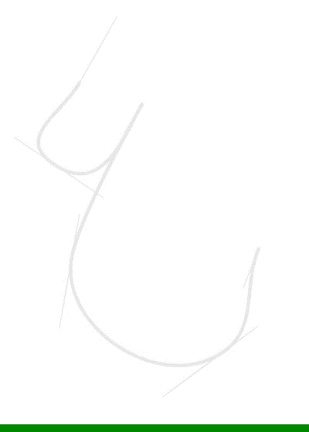
Problem Statement
A path construction using Bezier spline curves
Virtually, every shape can be constructed using these curves
It can also make closed paths: Font Glyphs

Slide 7

Problem Statement
Bezier spline curve split in sections
Shape of each section looks the same but is not truly independent.

Slide 8
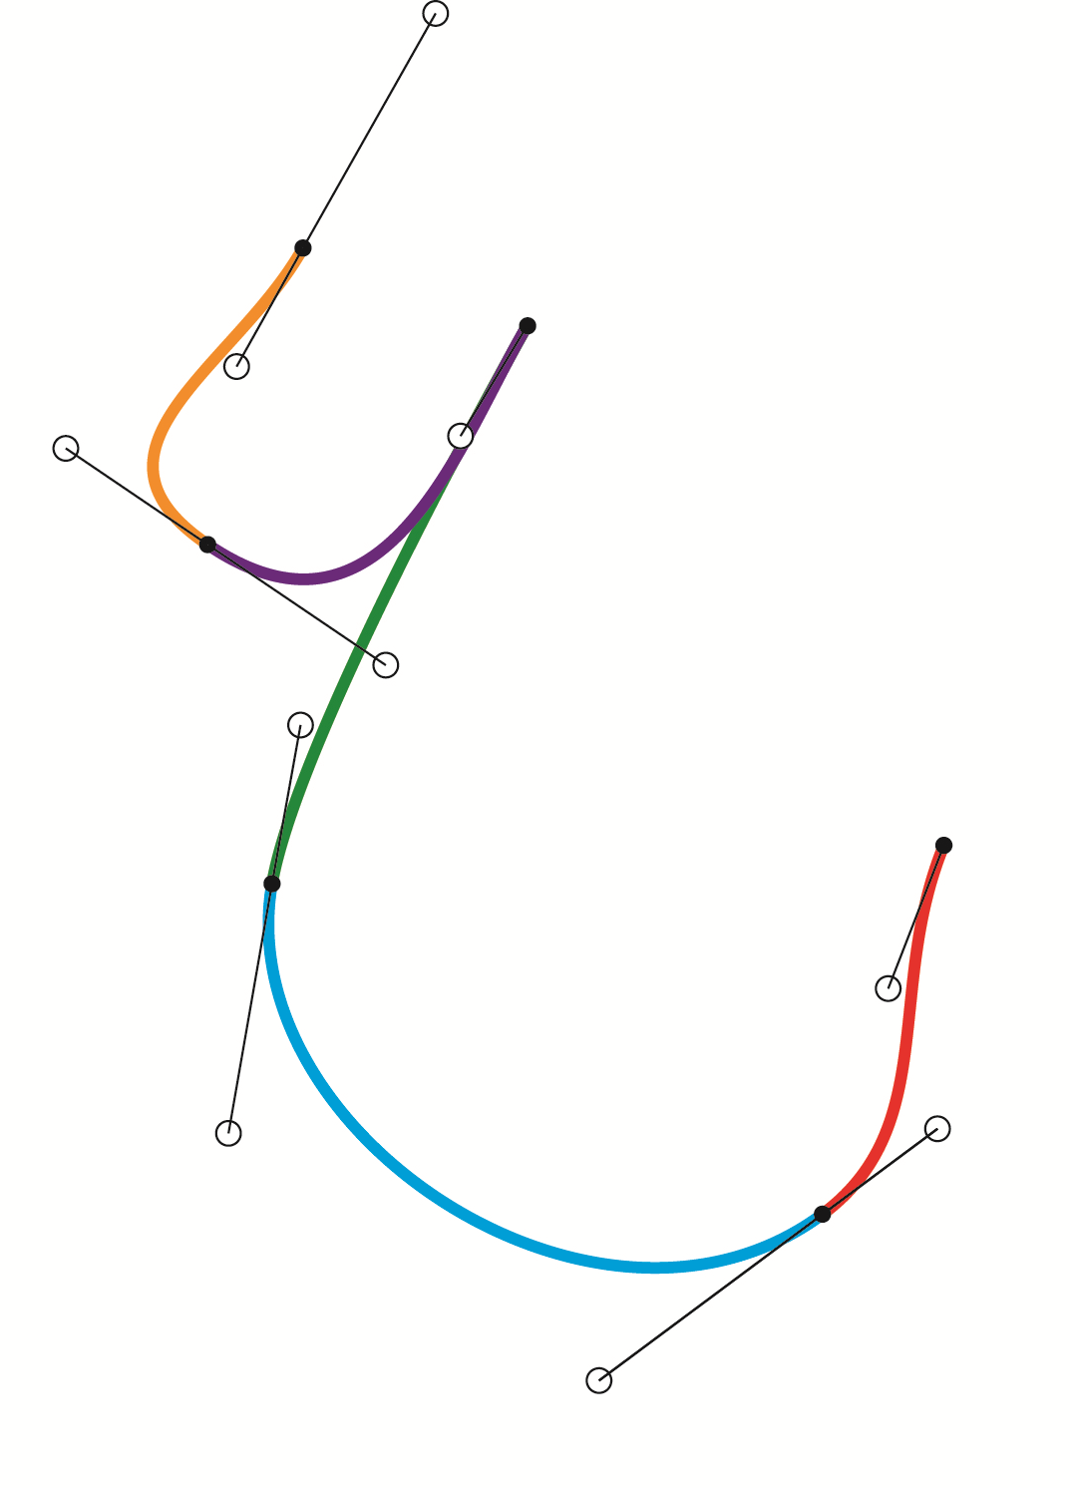
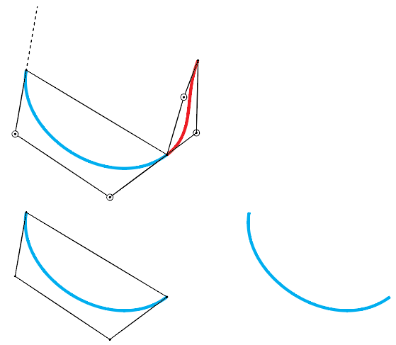
Problem Statement
One anchor defines the shape of two curve sections using a pair of curvature handles

Slide 9
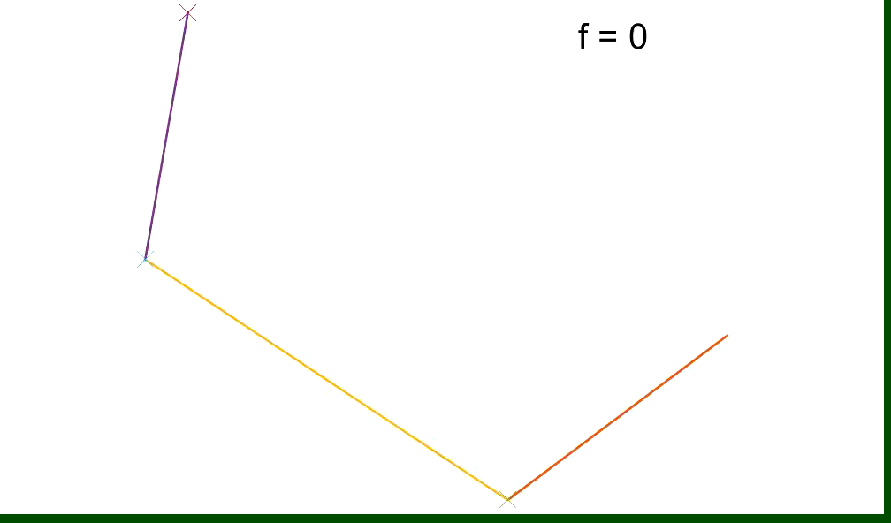
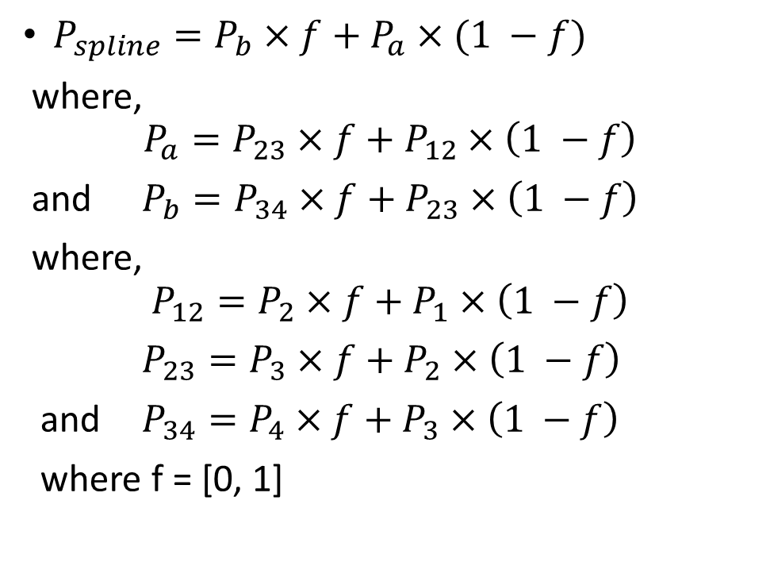
Problem Statement
Mathematical model of a Bezier Spline curve
$P_{spline}=P_{b}×f+P_{a}×(1 −f)$
where,
$$P_{a}=P_{23}×f+P_{12}×\left(1 −f\right)$$
and $P_{b}=P_{34}×f+P_{23}×\left(1 −f\right)$
where,
$$P_{12}=P_{2}×f+P_{1}×\left(1 −f\right)$$
$P_{23}=P_{3}×f+P_{2}×\left(1 −f\right)$
and $P_{34}=P_{4}×f+P_{3}×\left(1 −f\right)$
where f = [0, 1]
P1
P2
P4
P3

Slide 10
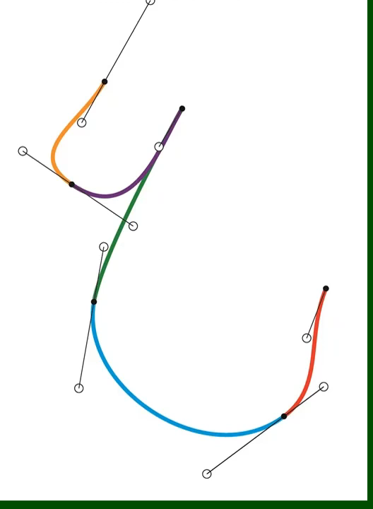
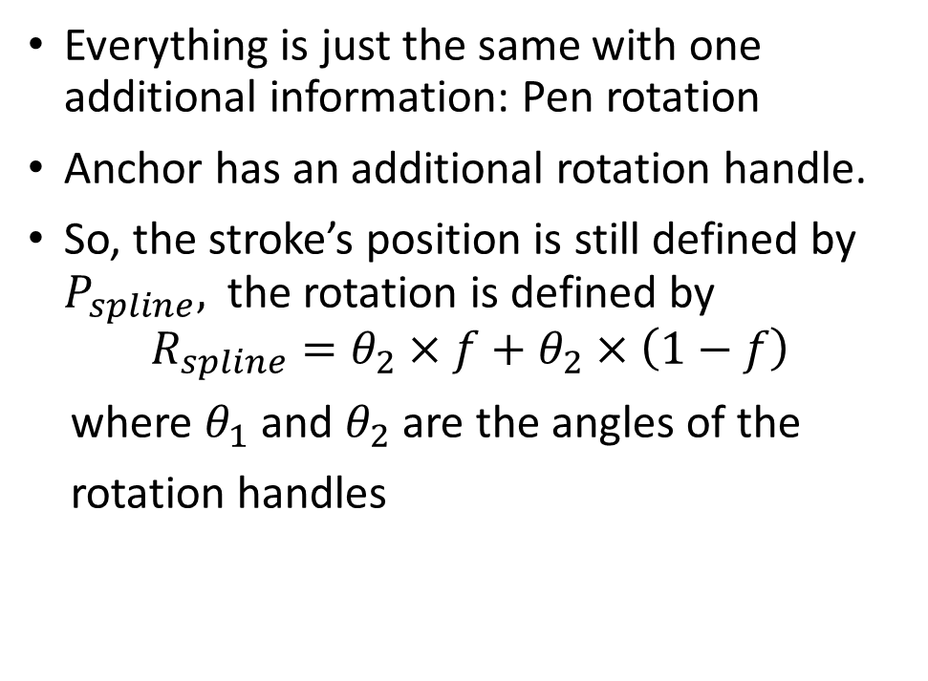
Problem Statement
Twisting Bezier spline curve
Everything is just the same with one additional information: Pen rotation
Anchor has an additional rotation handle.
So, the stroke’s position is still defined by $P_{spline},$ the rotation is defined by
$$R_{spline}=θ_{2}×f+θ_{2}×\left(1−f\right)$$
where $θ_{1}$ and $θ_{2}$are the angles of the
rotation handles

Slide 11
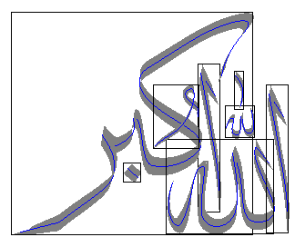
Problem Statement
Twisting Bezier spline curve
Rotation handle
Brush/pen inclination handle
Pressure handle
Velocity handle

Slide 12
Problem Statement
Why Twisting Bezier spline curve?
Easy editing
Accuracy
Straight forward machine code generation

Slide 13
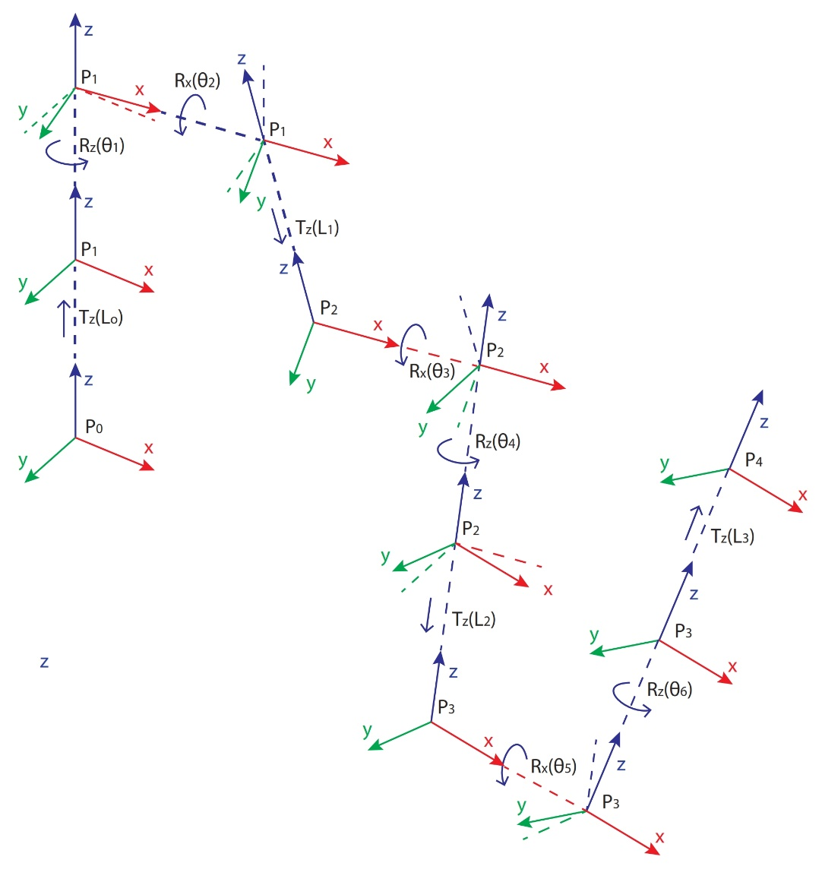
Problem Statement
Robot Configuration
6 DoF
All Revolute joints

Slide 14
Homework Done
Implemented
Two inverse kinematic solutions
Basic GUI
Rudimentary twisting Bezier spline editor
Missing
Twist angles in the range of one rotation
Workspace analysis tools
Fully equipped calligraphy editor

Slide 15
Work Plan
Task | Workload | Deadline
Bugs Correction in Drogon 2.0 | 30 Days | July 10, 2020
Framework for hardware communication | 10 Days | July 20, 2020
Integration of simulation components | 10 days | July 30, 2020
Composition of documentation | 10 days | Aug 10, 2020

